Slide 1
Drivers briefing
Croft – 17 / 18 September 2022
Graham Lindley – Clerk of the Course
Nankang Tyre BRSCC City Car Cup
Track Attack Race Club

Slide 2
General
Please remember to read the Final Instructions and any other instructions for your championship or series.
We will be running to timetable and so please be ready and listen to announcements in the paddock
Ensure you have a ticket for yourself and your immediate crew. Without a competitor ticket you will not be allowed in the paddock
Park sensibly in the paddock
When you are out on track please make sure all your personal belongings are secure in the paddock!

Slide 3
Scrutineering
Please ensure:
Car is empty of anything non race related (bags, shoes, jerry cans etc)
Make sure NOTHING is loose and that could roll around inside.
Check fire extinguisher PIN is armed
Ensure transponder subscription is up to date and on
Check seat belts are untwisted
Rain light works (and you know which switch it is)
Video camera charged and focused on the right image, and working! NO MOBILE PHONES (in the car / or your pockets)

Slide 4
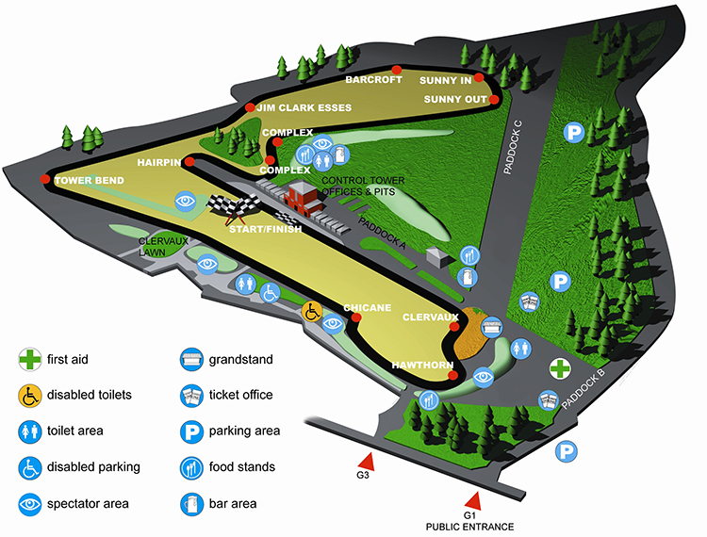
Track layout

Slide 5
Pit lane
During the start of a race, no personnel are allowed on the Pit Wall until all the cars are clear of the grid.

Slide 6
Qualifying
Cars will be assembled in Assembly ready for each session
Please be ready in the Assembly Area twenty minutes before your session
All cars will be noise tested prior to their first session on the circuit entry to the Assembly Area
Cars will be released from the Assembly and out onto the circuit at turn 1 as directed by marshals.
1st lap, please note the positions of the flag points and signalling lights, which may be different from any testing events.
Each driver MUST get three timed laps completed
If we have to RED flag in qualifying we will need you to return to the PIT LANE
End of the track session, please complete a slowing down lap, exit the circuit at the pit entry and proceed straight through the pit lane to parc ferme
Note: Should any practice session be disrupted the Clerk of the Course shall not be obliged to resume or re-run the session; the decision of the Clerk of the Course shall be final. Each driver must complete a minimum of 3 laps in the car to be raced and in the correct session in order to qualify. Motorsport UK regulations (Q12.4). The Clerk of the Course and/or Stewards of the Meeting shall have the right to exclude any driver whose practice times or racing are considered unsatisfactory as per Motorsport UK Regulation Q12.4.3.

Slide 7
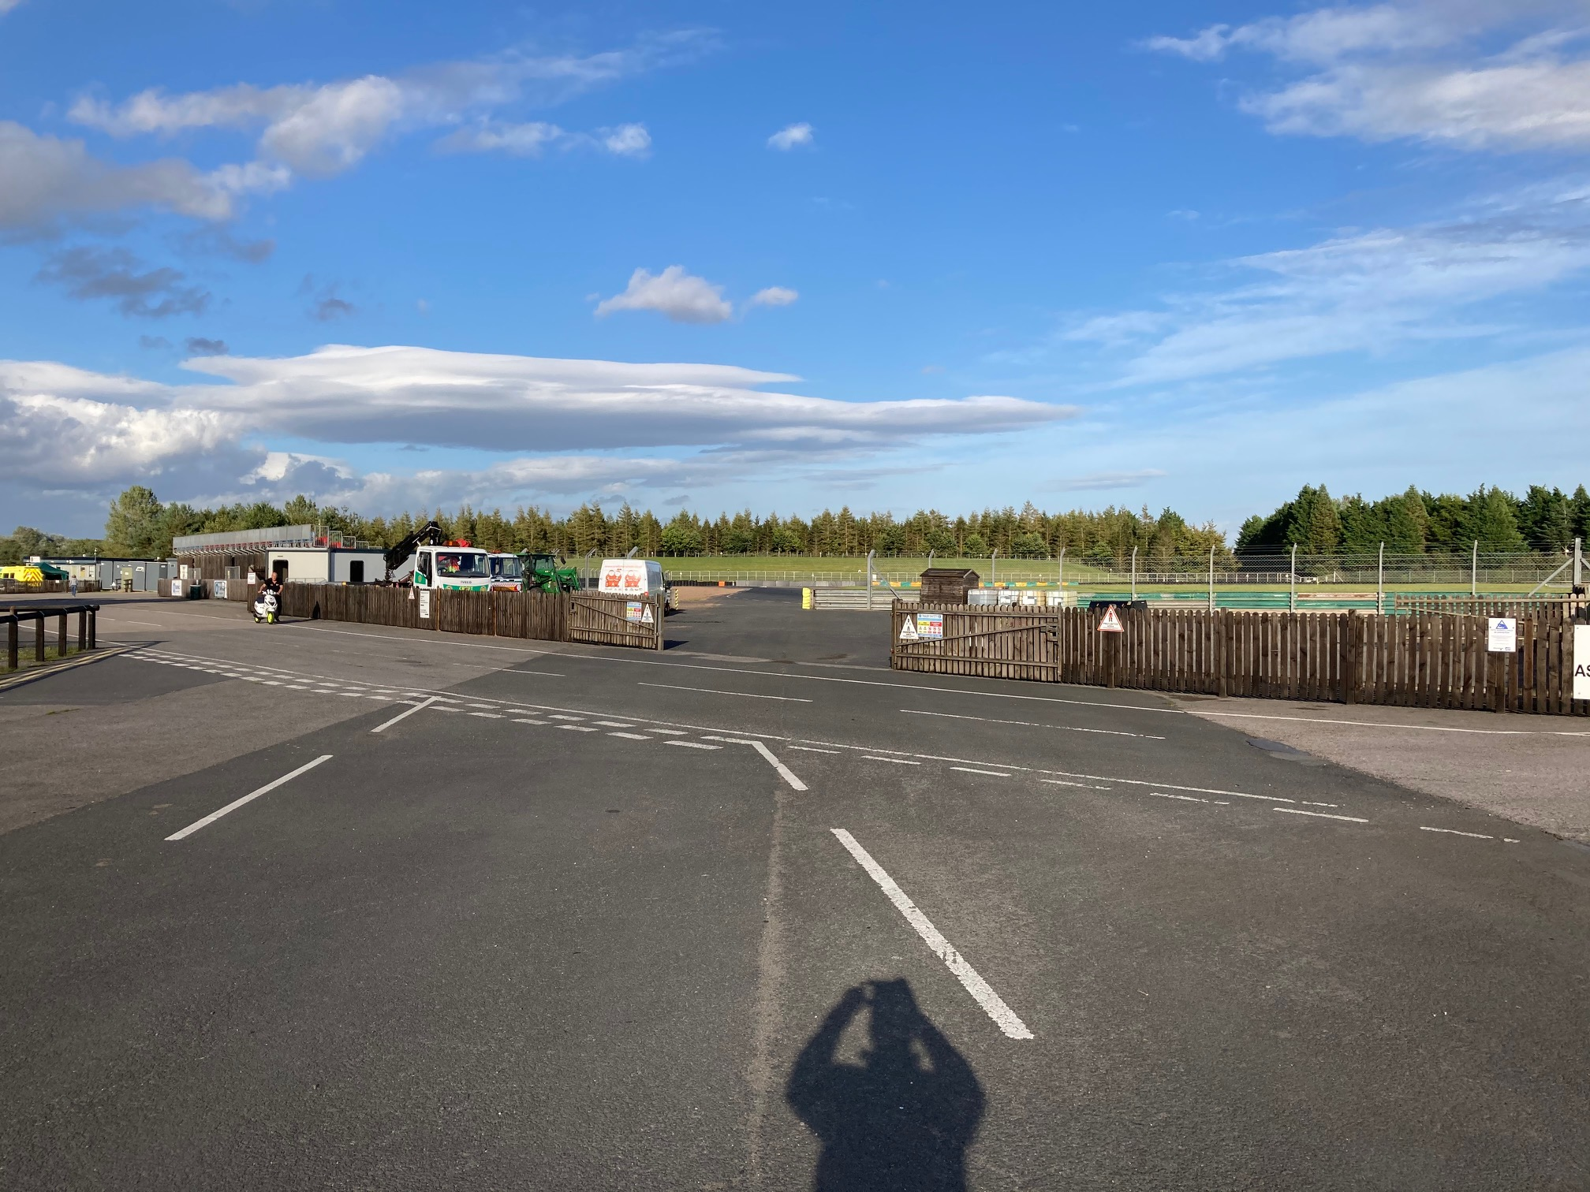
Assembly area
ASSEMBLY AREA
The assembly area is located behind Clervaux. Access to the assembly area is from the Paddock side.
To
Track

Slide 8
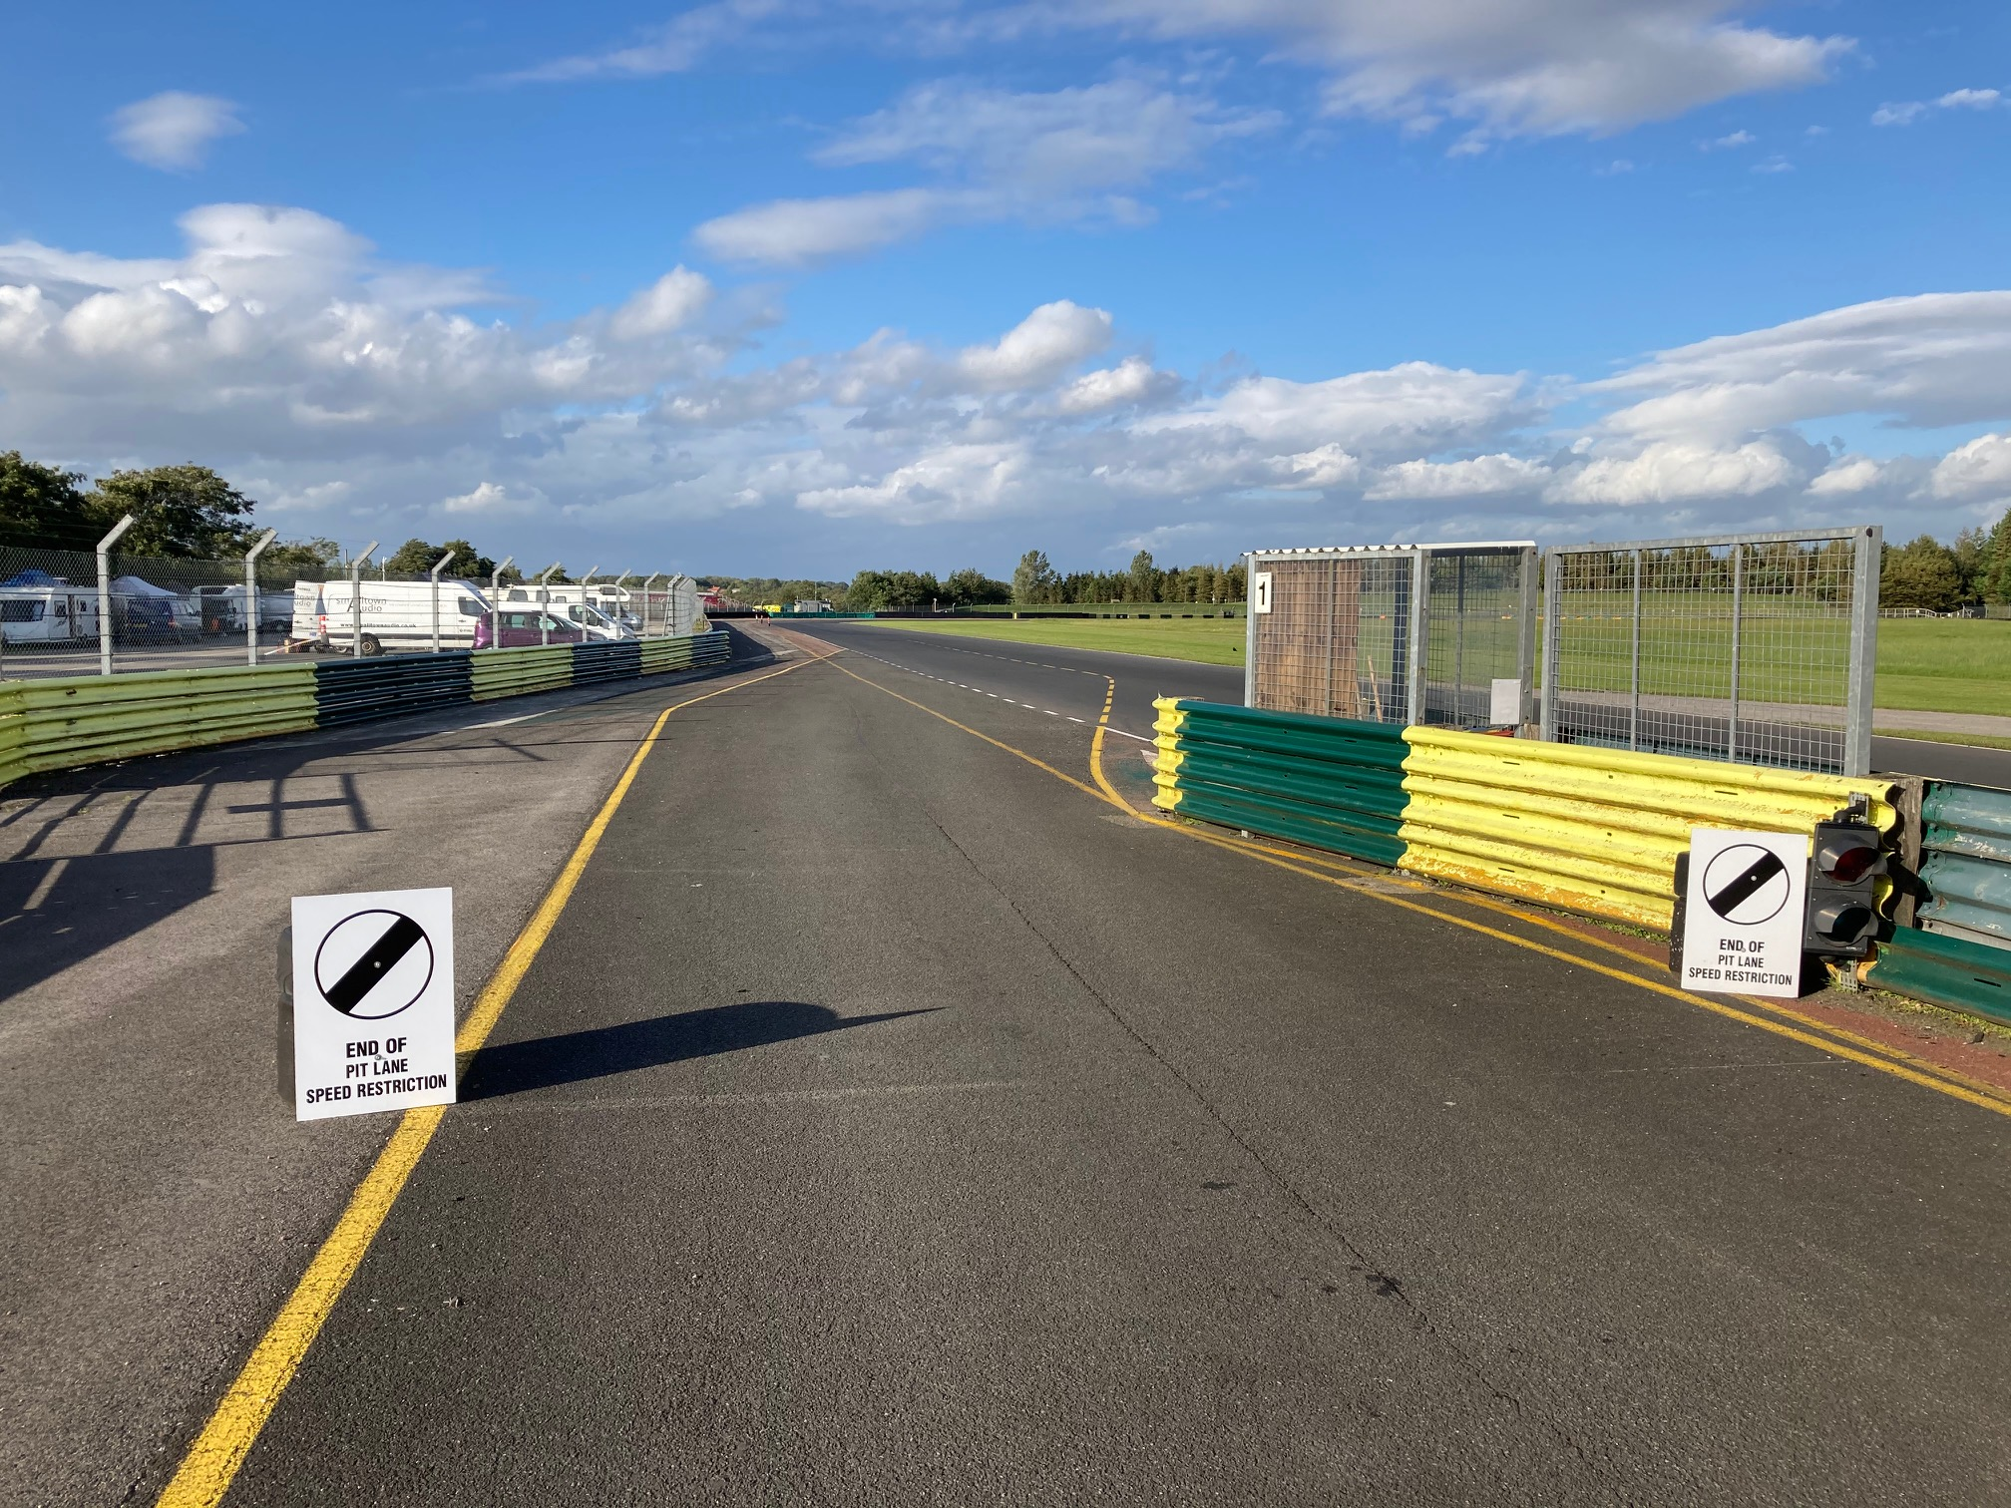
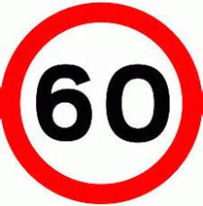
Pit Lane exit
Please observe the blend line when exiting the pit lane
Observe speed limit until after you pass the pit exit lane
Pit lane speed limit is 60 km/h..

Slide 9
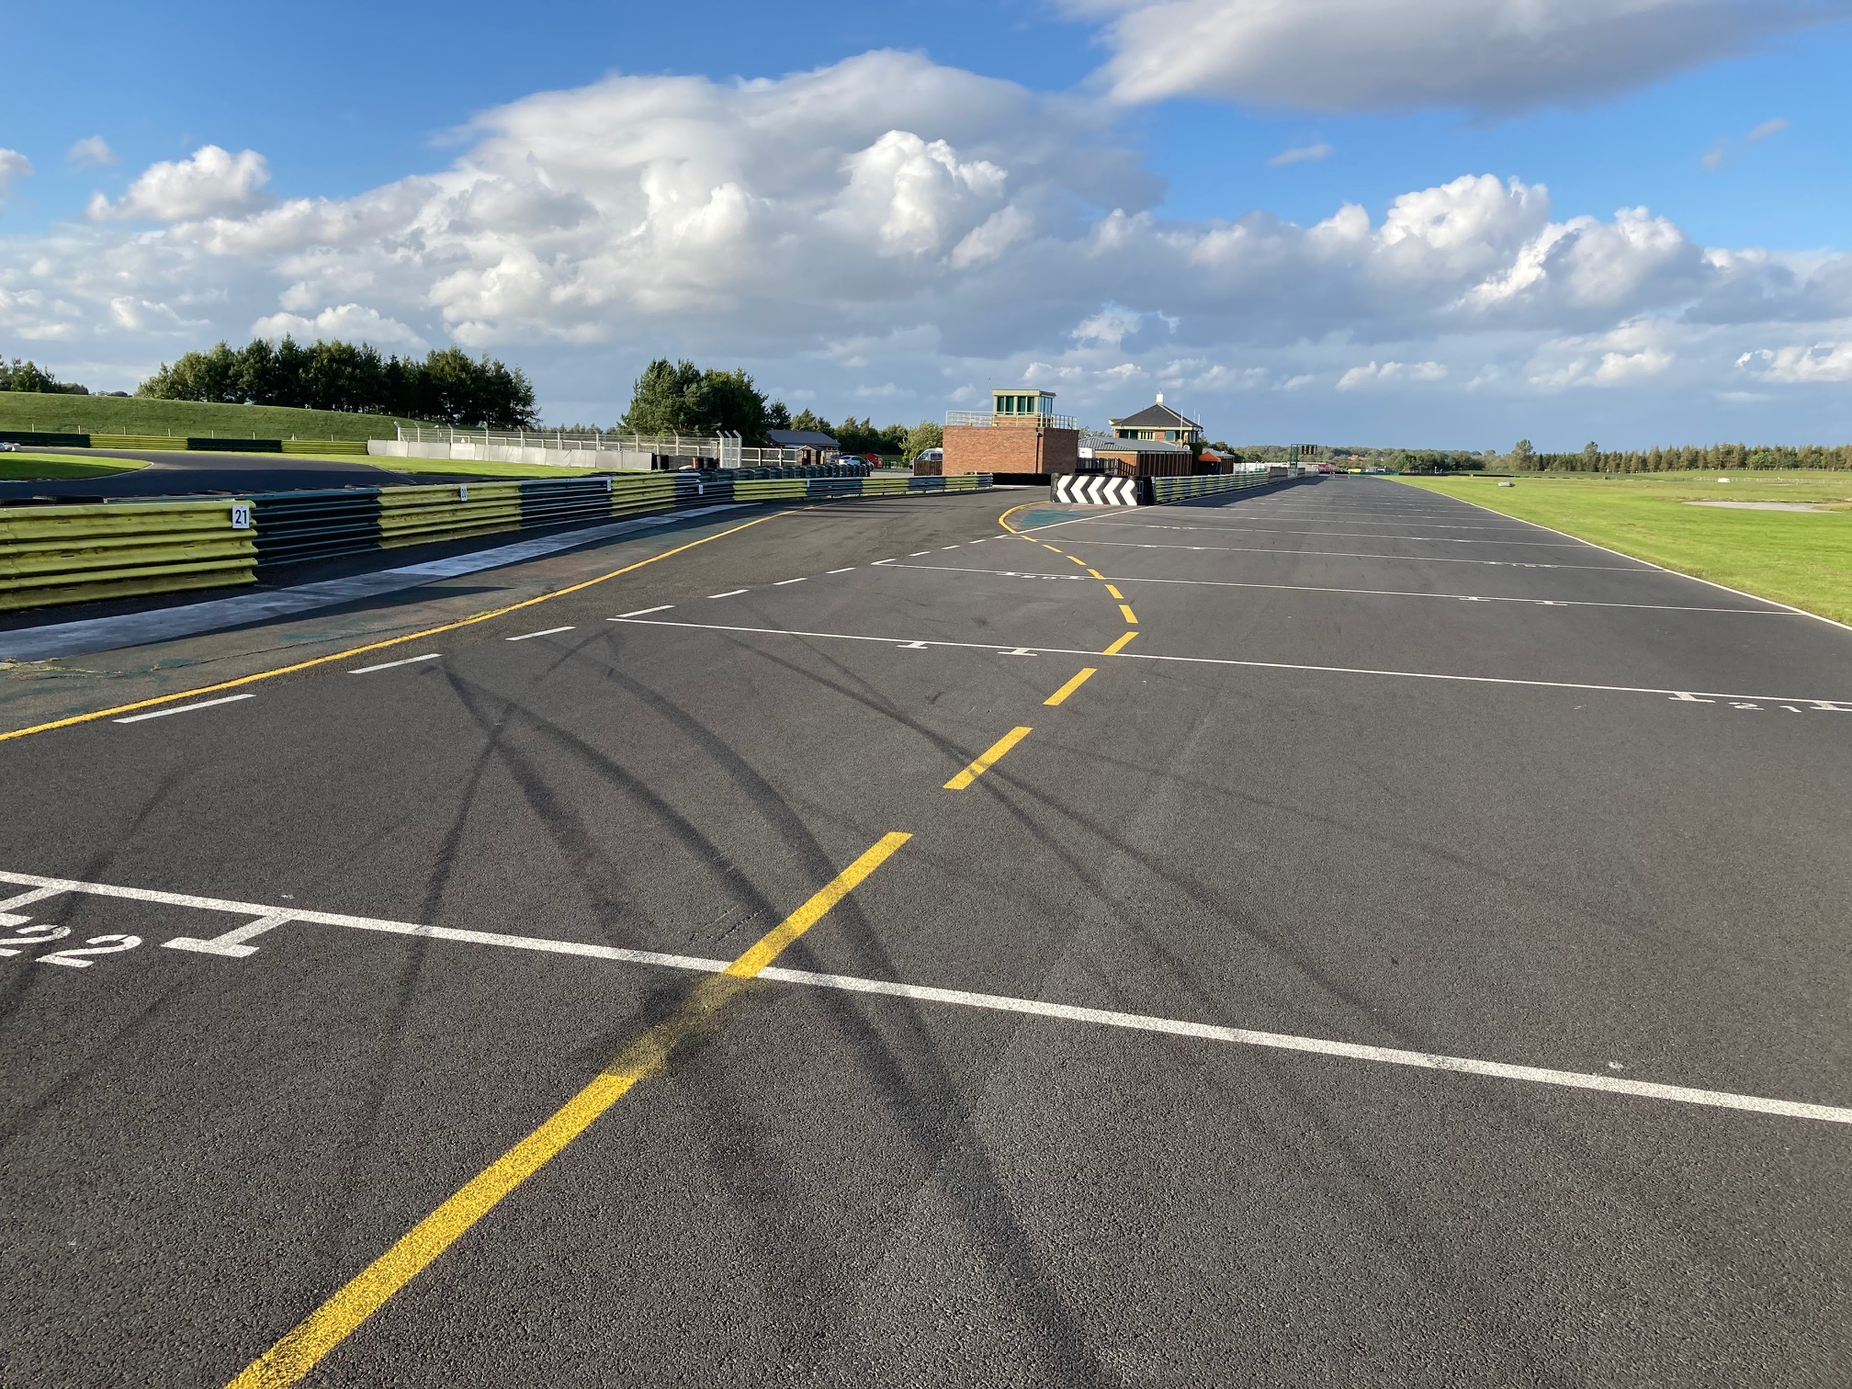
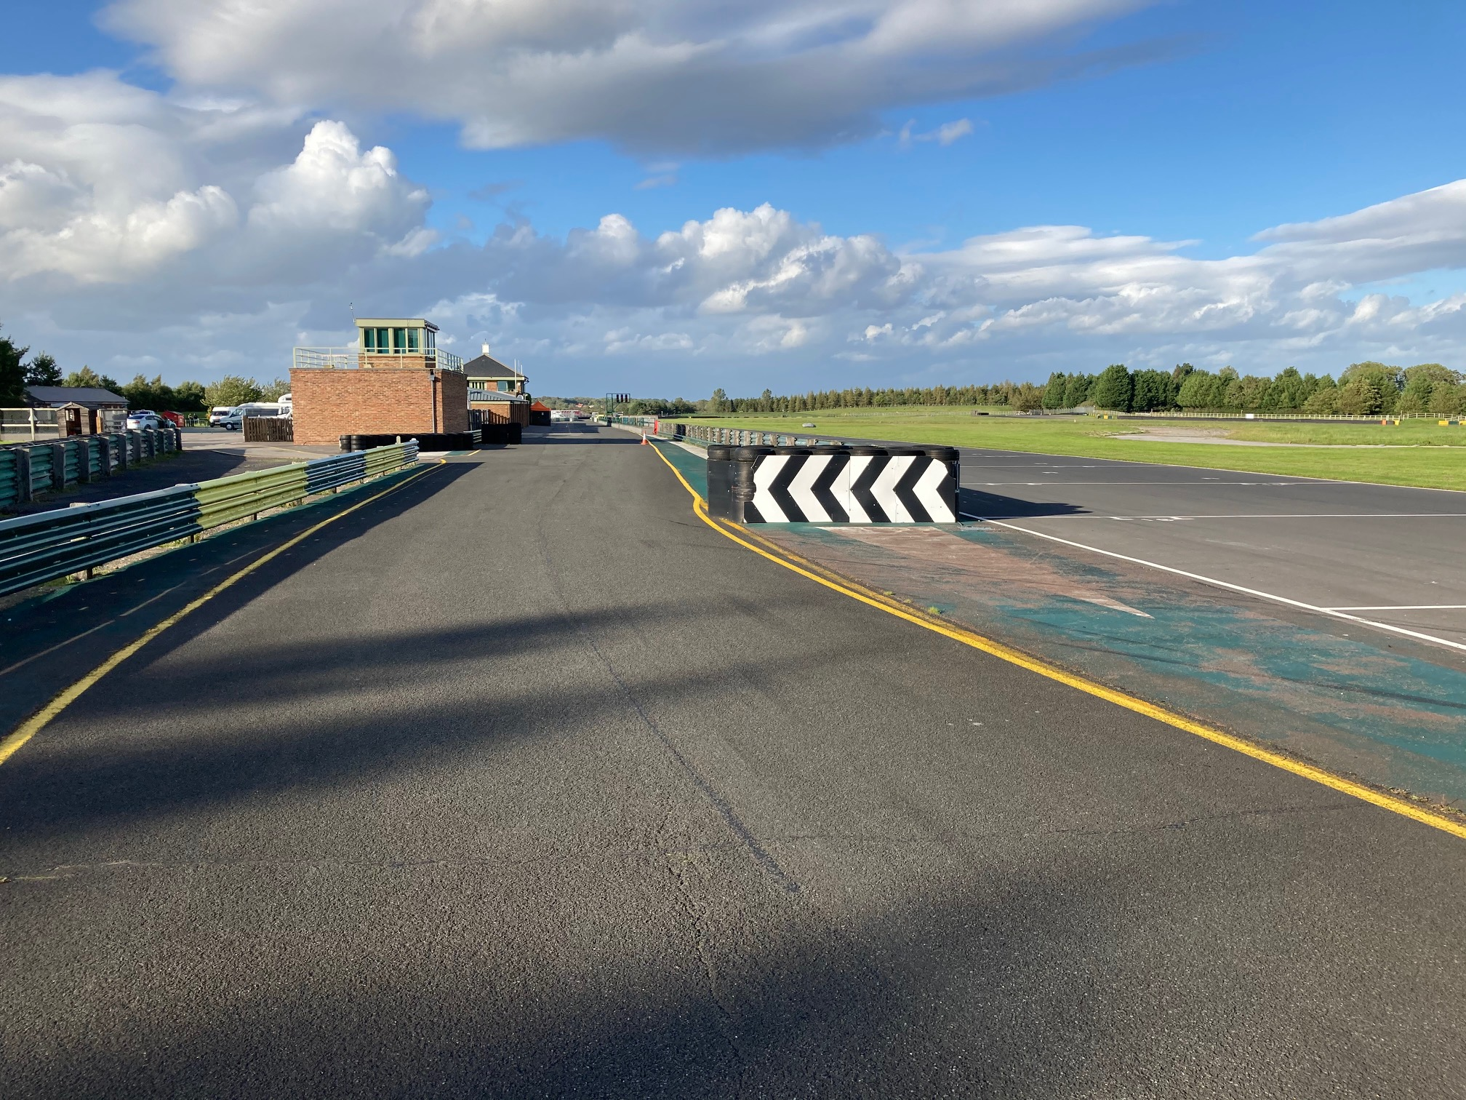
Pit lane entry

Slide 10
Yellow Flag:
Danger
No overtaking
MUST BE OBSERVED
No overtaking until after the Green Flag at the next post
NOT SEEING IS NO EXCUSE
PENALTY possible DISQUALIFICATION
Flag signals, please respect our flag signals, if we have issues with drivers not respecting yellow flags, we may be forced to stop the session and you will loose track time. This is not fair on your racing colleagues. YELLOW FLAGS are there and used for a reason, the consequences of not slowing or respecting them can lead to greater issues.

Slide 11
Red Flag:
Stop racing
No overtaking
Qualifying: Return to Pit Lane
Race: Return to Start Line
Or as directed by Marshals
Note: Should the need arise to stop any race or practice, RED LIGHTS will be switched on at the Start Line and RED FLAGS will be displayed at the start line and at all Marshals Signalling Points around the circuit. This is the signal for all drivers to cease circulating at racing speeds, to slow to a safe and reasonable pace and to return to the pit lane, during practice, and to the starting grid area, during a race, unless otherwise directed by officials. Cars must not enter the pits unless directed to do so (Race) and all cars in the pit lane during a red flag period must take any restart from the pit exit.

Slide 12
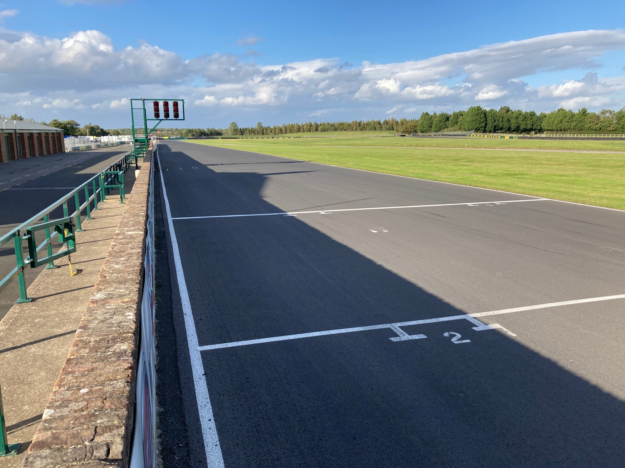
Signaling area
On the start-line the following flags may be shown
The Black and White, the Black and Orange and Drive Through board will also be displayed with a car number – please obey this instruction if shown for you car.

Slide 13
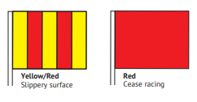
Officials’ Signals will be conveyed to drivers by the following flag signals which may be displayed by an appropriately coloured panel to which the competitor number may be attached:
Blue flag – Stationary: Another competitor is following close behind.
Blue flag – Waved: Another competitor is trying to overtake.
White flag: A service car or slow moving car is on the circuit. The white flag will be waved to indicate the sector of the track that the slow moving vehicle is in, and held stationary whilst the vehicle is in the next sector.
Yellow flag – Waved: Danger, slow down sufficiently to ensure that full control of the vehicle can be retained. No overtaking.
Yellow flag – Double Waved: Great danger. Slow down considerably. Be prepared to suddenly change from the projected racing line, or take other evasive action including stopping if necessary. No overtaking. (This signal may be supplemented or replaced by flashing yellow light(s), as an added warning.)
Yellow flag with Red Stripes – Stationary: Slippery surface ahead.
Yellow flag with Red Stripes – Waved: Slippery surface imminent.
Green flag – Waved: All clear, at the end of a danger area controlled by yellow flags. Also used to signal the start of a formation lap and shown at all posts during first lap of each practice session and during each formation lap.
Red flag: Immediately cease driving at racing speed and proceed slowly, without overtaking, and with maximum caution to pits or start line obeying marshal’s instructions and being prepared to stop should the track be blocked.
Black flag with Orange disc displayed with the competitor’s number: Notification of apparent mechanical failure or of a fire which might not be obvious to the driver. The car concerned must call at its pit for repairs on the next lap.
Black and White Rectangular flag split diagonally and displayed with the competitor’s number: A warning, to the driver that his behaviour is suspect and that he may be Black-flagged on further reports.
Black flag displayed with the competitor’s number: The driver must stop at his pit on the next lap of receiving the signal and report to the Clerk of the Course. A penalty of disqualification may be enforced by display of the Black flag.
Black and White Chequered flag: End of Race or Practice

Slide 14
Chequered flag
At the end of each session the chequered flag will be shown on the Start/Finish Line – PLEASE DO NOT MISS THIS FLAG.
After the chequered flag, immediately SLOW DOWN, and return to pit lane
Note: After taking the Chequered Flag drivers are required to:
progressively and safely slow down.
remain behind any competitors ahead of them,
return to the pit lane/paddock entrance as instructed,
comply with any directions given by marshals or officials
keep their helmets on and harnesses done up while on the circuit or moving in the pit lane.

Slide 15
Race (standing start)
All cars will be released from assembly at turn 1 in grid order after the 1 minute, 30 second boards have been shown followed by the green flag.
The lap from the assembly to the grid will constitute the Green Flag Lap. Please keep in formation
The start will be via a standing start.
The minimum countdown procedures/audible warning sequence shall be:
Once the Green Flag Lap is completed and all the cars are on the grid.
A five second board will be used to indicate that the grid is complete after the green flag lap.
The red lights will be switched on, and at some time between 2-7secs the red lights will switch off – signalling the start of the race.
Any car removed from the grid after the 1-minute stage or driven into the pits on the Green Flag lap shall be held in the pit lane and may start the race after the last car to take the start from the grid has passed the start line or pit lane exit, whichever is the later
In the case of starting lights failure, the Union flag will be used instead. No team personnel are allowed on the pit wall for the start of the race

Slide 16
Blue Flag
Blue flag – Stationary: Another competitor is following close behind
Blue flag – Waved: Another competitor is trying to overtake
Any driver not observing blue flags will be reported and may be penalised

Slide 17
Start line
Start & Red Line
Starting Lights

Slide 18
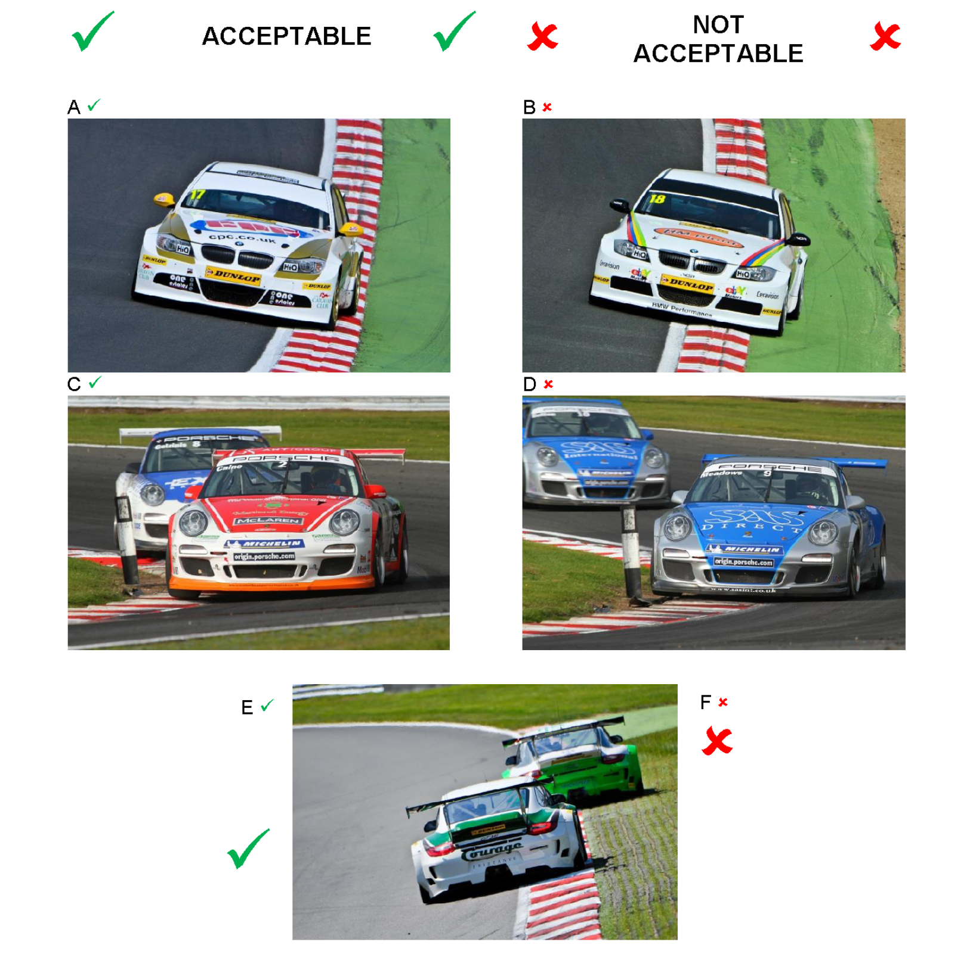
Track limits
Track limits will be monitored and penalties issued for exceeding track limits for qualifying and race sessions
Track limits will be monitored by Judge of Fact at
Turn 2/3 Hawthorns
Turn 9 Jim Clerk Esses
PLEASE ensure that you note the track limits, one or two hotspots here, you will have the lap time removed if you exceed the track limits. If it is persistent, then I will black flag you.
Please note that in qualifying a Black and White flag signal need not be shown. Please respect the track limits and penalties will be applied for any breaches, during qualifying lap times will be removed and for racing, penalties will be applied as follows:
1st offence – noted
2nd offence – black and white warning flag
3rd offence – 5 second penalty
4th offence – 10 second penalty
5th offence – drive through penalty
6th offence – disqualification

Slide 19
Parc Ferme
Remember with PARC FERME you are on your own, no adjustments to the car, tyres etc, no family, team or friends (and please remain in your car in parc ferme, but you can remove your helmets and balaclavas)
Parc Ferme – please make sure your team and family are social distancing
Note: At all events the showing of the Chequered Flag (for both Qualifying and Racing) will indicate the commencement of Parc Fermé Regulations. Any vehicle that is in the pit lane at this time will be under Parc Fermé rules. It is prohibited to work on any vehicle after the chequered flag has been shown. This includes tyre pressure checking, wheel changes or changes of driver. Any vehicle in the pit lane must be immediately taken to the designated Parc Fermé area. No team personnel may enter Parc Fermé unless authorised by the Eligibility Scrutineer or their Deputy. No tools of any type may be passed by team members or mechanics to drivers whilst in Parc Fermé. Competitors are reminded that the area designated as Parc Fermé area is a secure area and it is not permitted for any supporters to be in Parc Fermé unless at the request of the eligibility scrutineer or their deputy

Slide 20
Safety Car race only
As soon as the Safety Car boards and flags are displayed immediately stop racing and slow down and no overtaking!
The Safety Car itself may not have been deployed when the boards and flags are displayed but cease racing
The safety car will join the track from the pit lane exit
Please join the crocodile behind the safety car and maintain a pace with all other cars, allowing us to clear the circuit
In the event of an incident at the start of the race the safety car may be deployed from the pit lane entry
On restart the lights will be extinguished and the car will return to pitlane. The leader will set the pace and you cannot pass another car until you have passed the GREEN flag on the start line

Slide 21
Safety on Track
If you need help on track please try to stop in a SAFE place near a marshals post
If the car is in a safe place, get out of the car and over the barrier and to a place of safety
If you remain in the car give the thumbs up to marshals if you are okay
Heavy braking corners – please respect other people at these corners, you can get round 2 cars, but it will be a place that contact is avoidable if you respect each other
Corners where you need to respect each other and give each other room is T1 Clervaux (particularly on the first lap), also the Hairpin, no lunges or contact here!

Slide 22
Driving standards
Remember this is a NON CONTACT sport
You need to be aware of all other cars around you at all times
Make sure the overtake can be completed without contact
Contact is expensive and potentially dangerous
Reported incidents will be investigated and judicial action may be taken
You may Only Change Direction Once in front of the pursuing car, that is to say you can only move left or right in front of the car, not both
Pushing or Squeezing competitors off the track is strictly forbidden i.e. reducing the available track width to less than a car’s width
Unpredictable moves causes incidents!

Slide 23
RACE WITH RESPECT
Please remember the values of the Motorsport UK Respect Code
Respect
Integrity
Self-Control
Fair Play
Good Manners

Slide 24
Judicial
You may lodge a protest with the secretary of the meeting contactable on the race telephone number published in the final instructions
If you are reported for a race incident then the co-ordinators will collect your SD card and seal it into an envelope
If you are then requested to attend a race investigation with the clerk please come to the Clerks Office on the first floor of the Race Control building (or this maybe carried out by telephone). Please ensure you comply with social distancing at all times.
Any SD cards will be returned to you via the co-ordinator once the video incident has been reviewed

Slide 25
Enjoy
Remember to enjoy the experience
If you have any questions during the day please contact one of your co-ordinators or get in touch with race control by phone
Thank you!
Graham Lindley – Clerk of the Course

